Slide 1
INTRODUCTION TO I/O
Many C++ I/O features are object-oriented
Use references, function overloading and operator overloading
C++ uses type safe I/O
Each I/O operation is automatically performed in a manner sensitive to the data type
if no I/O function exists for a given type, then compiler notes as error
Extensibility
Users may specify I/O of user-defined types as well as standard types

Slide 2
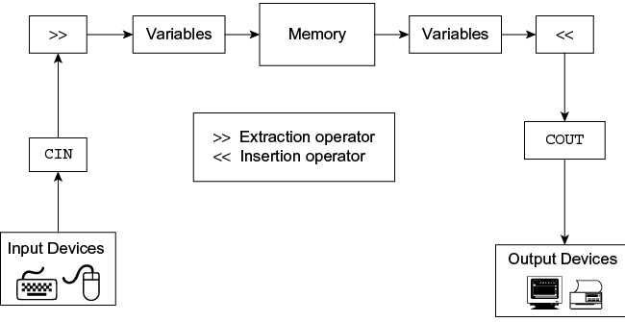
Streams & I/O

Slide 3
STREAMS & I/O
Stream
A transfer of information in the form of a sequence of bytes
I/O Operations:
Input: A stream that flows from an input device ( i.e.: keyboard, disk drive, network connection) to main memory
Output: A stream that flows from main memory to an output device ( i.e.: screen, printer, disk drive, network connection)
Applications associate meaning to the bytes
I/O is extremely slow compared to processing speeds
C++ provides both formatted and unformatted I/O

Slide 4
STREAM & I/O
C++ views each files as a sequence of bytes.
Each file ends with an end-of-file marker.
When a file is opened, an object is created and a stream is associated with the object.
To perform file processing in C++, the namespaces <iostream> and <fstream> must be included.
<fstream> includes <ifstream> and <ofstream>

Slide 5
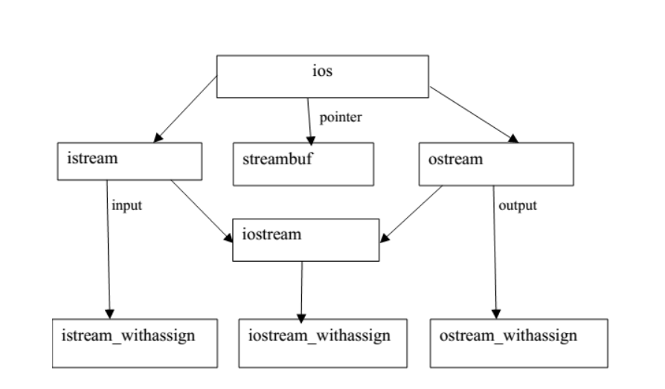
Stream Class Hierarchy

Slide 6
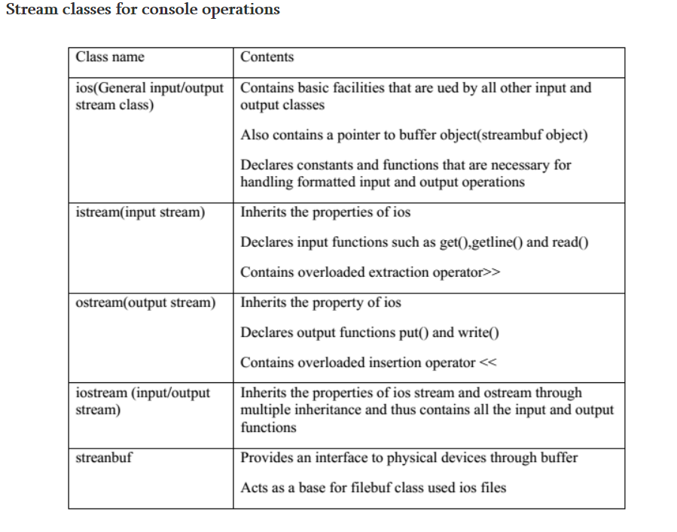

Slide 7
Unformatted I/O Operatons 1) Stream-extraction and insertion Operator
>> operator overloaded to read data items of( by extraction operator)
built in types
Strings
<< operator overloaded to output data items of(insertion operator)
built in types
strings
pointer values
Normally skips tabs/whitespace/newlines
The inputs/outputs can be cascaded
Eg.,cin>>a>>b>>str; cout<<str<<b;

Slide 8
2) get and getline Member Functions
cin.get(ch); // new version
reads value from stream into ch
returns 0 when eof encountered
otherwise returns reference to stream object (for cascading)
cin.get (name, 30,'\n'); // 3rd version
30 specifies max number of characters
'\n' terminates input
'\n' not consumed

Slide 9
get and getline Member Functions
cin.getline(name,30,'\n');
Similar to cin.get( … )
Difference is that the getline version will "consume" the '\n' (or whatever delimiter is specified)
Need to be aware of using cin.ignore if we know '\n' will still be in the stream

Slide 10
3) Char Output with put
put is a member function of ostream
Sends a single character value to the output stream
The function returns reference to object which called it (cout)
thus can be cascaded cout.put('W').put('O').put('W');
Integer value parameter taken in as ASCII character number

Slide 11
4) istream Member Functions
ignore -- skips over designated number of characters
putback -- places character previously obtained with get back onto input stream
good for scanning a stream looking for specific character
peek -- returns next character in stream without getting it off the stream

Slide 12
5)Read and write
Performed with read and write member functions
They take two parameters
an array of char or a buffer
a number which tells how many characters cin.read(buffer,20); cin.write (buffer,15);

Slide 13
Formatted I/O Console
Features that could be used for formatting the output
ios class functions and flags
Manipulators
User – defined output functions

Slide 14
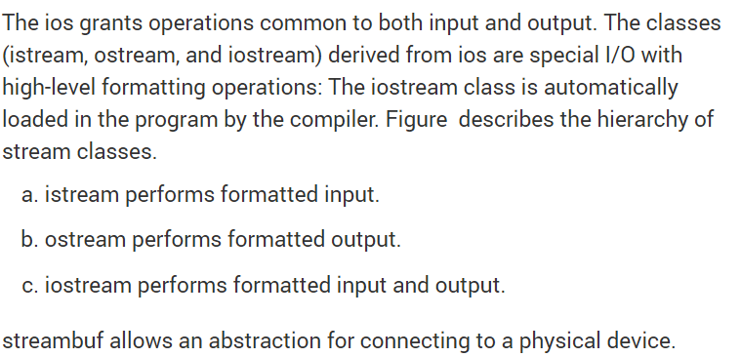

Slide 15
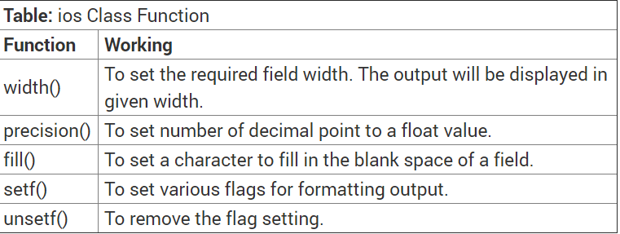
ios class formatting functions

Slide 16
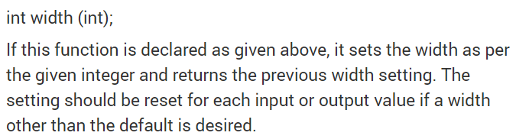
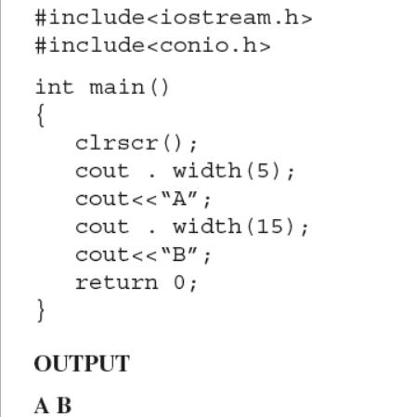
1) width(int)

Slide 17
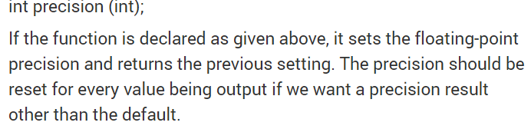
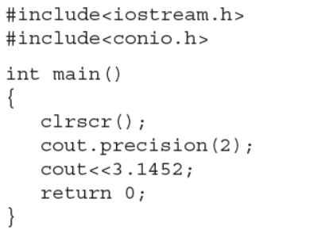
2) precision

Slide 18
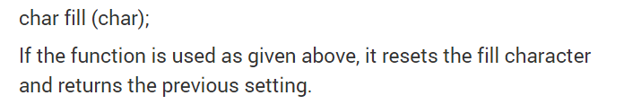
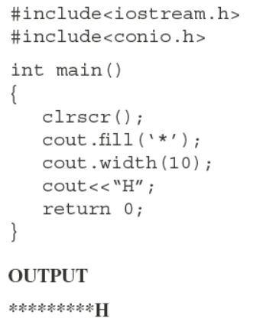
3) fill

Slide 19
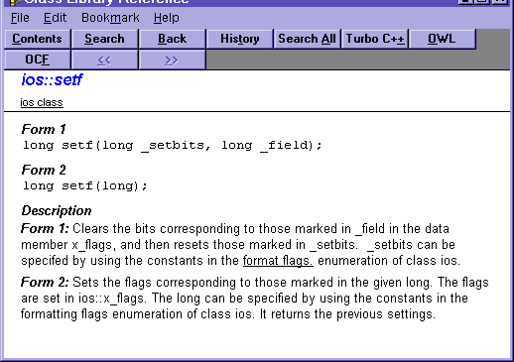
Forms of setf( )

Slide 20
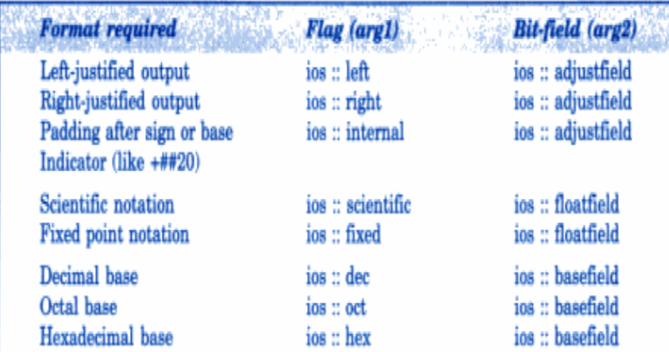
4) setf

Slide 21
Justification
Use ios::left ios::right ios::internal
Right justification is default with setw( )
padded characters added on right when ios::left is specified
ios::internal => a number's sign left justified, magnitude right justified

Slide 22
Floating-Point Numbers
We have used in previous course cout.setf (ios::fixed, ios::floatfield);
Also possible to specify scientific notation cout.setf (ios::scientific, ios::floatfield);
Can be turned off with cout.unsetf (ios::scientific);

Slide 23
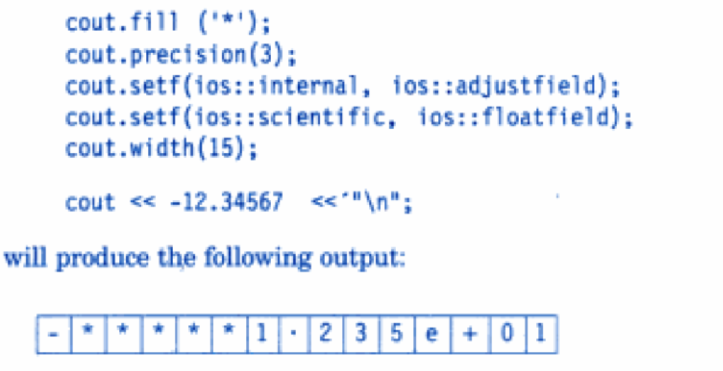

Slide 24
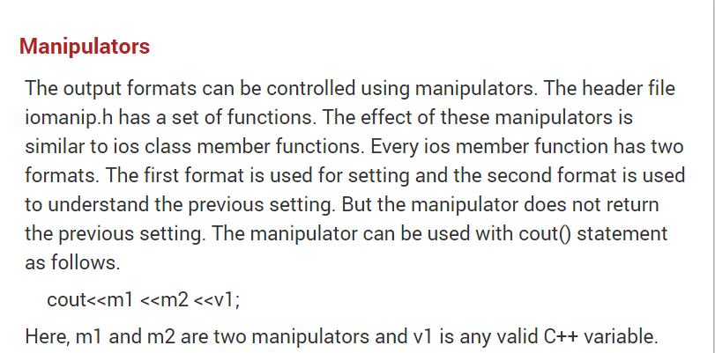
Manipulating the output with manipulators

Slide 25
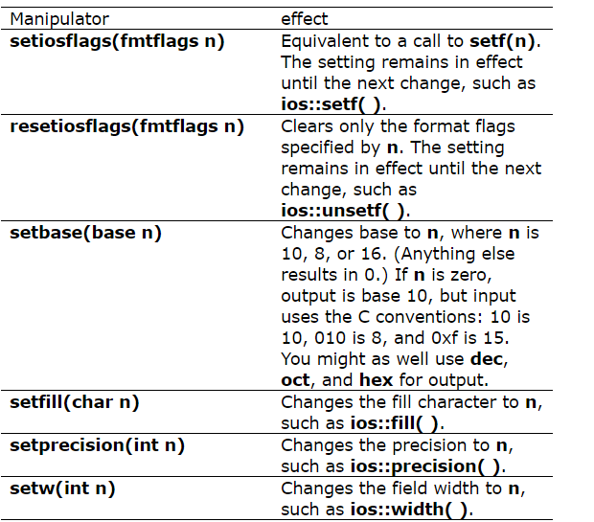
Manipulating the output with manipulators

Slide 26
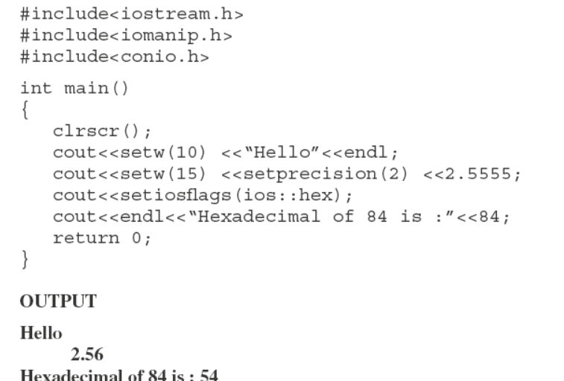
Example with manipulators

Slide 27
Other cases Uppercase/Lowercase Control
Forces uppercase letters for
scientific notation
hex notation
Use cout << setiosflags (ios::uppercase) << 1.23e6;

Slide 28
Integral Stream Base: dec, oct, hex and setbase
Integers normally interpred as base 10 (decimal) values
Make sure to #include <iomanip.h>
Specify other bases with
hex for base 16 (hexadecimal)
oct for base 8 (octal) cout << n << " = " << oct << n << " in octal";
setbase:
Changes base of integer output
Accepts an integer argument (10, 8, or 16)
cout << setbase(16) << n;
Parameterized stream manipulator - takes an argument

